Slide 1
A New MEAN Stack
Christian Dinh
Cesar Rios
Hao-Hsiang Chi

Slide 2
Application URL
https://apex.oracle.com/pls/apex/f?p=54058:1:103439119628502:::::

Slide 3
Overview
Created an APEX application using a NoSQL database
Uses REST web service references
Needs access to a RESTful API
Needs a REST server
We set one up
We have a real client!

Slide 4
The Stack
MongoDB (with Mongoose.js)
Express.js
APEX
Node.js

Slide 5
Features
Implemented So Far
Requested by Client
Log in using email address and password
Register as either a ‘Stylist’ or an ‘Enthusiast’
Search for stylists based on location
Author posts as either user type
Search for posts using tags
View all posts from a stylist
Comment on and “like” posts
Homepage should display most “liked” posts and recent stylist posts
Stylist ratings and reviews
Search for stylist by price range
Connect to social media
User profiles

Slide 6
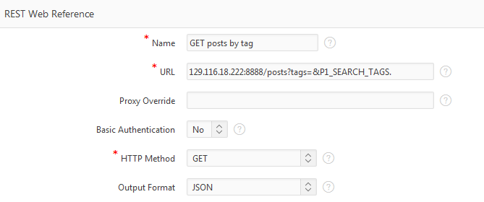
Web Service Reference: GET

Slide 7
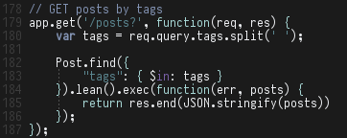
Web Service Reference: GET

Slide 8
Web Service Reference: GET
APEX app sends a request to the server
The server responds with a JSON object
APEX stores the response in a temporary collection
APEX runs a PL/SQL procedure to turn the JSON into an XMLtable and then into a table on a report

Slide 9
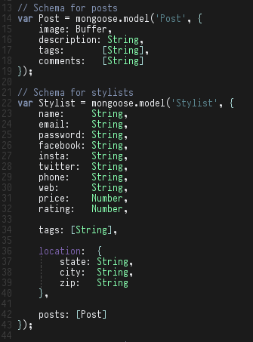
From JSON to XMLtable to Report

Slide 10
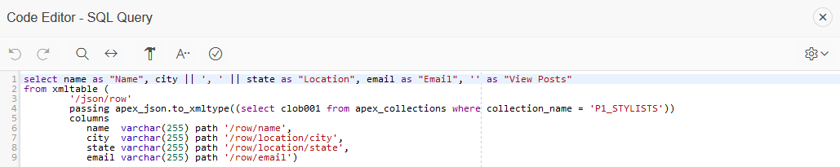
From JSON to XMLtable to Report

Slide 11
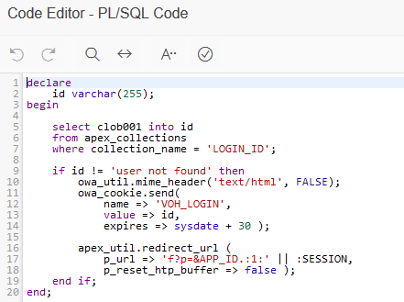
Rolling our own authentication
Insert browser cookies on log in using PL/SQL
Name: “VOH_LOGIN”
Value: the _id field in the user’s “Stylist” or “Enthusiast” document
This is a bad idea
It works!

Slide 12
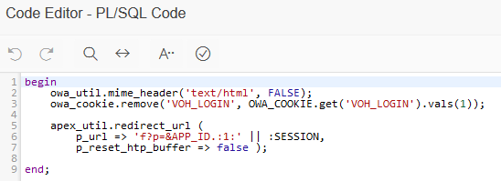
Rolling our own authentication
Removing cookies on log out works the same way

Slide 13
DEMO TIME
Starring Kevin Chi

